Slide 1
CSS GRID LAYOUT

Slide 3
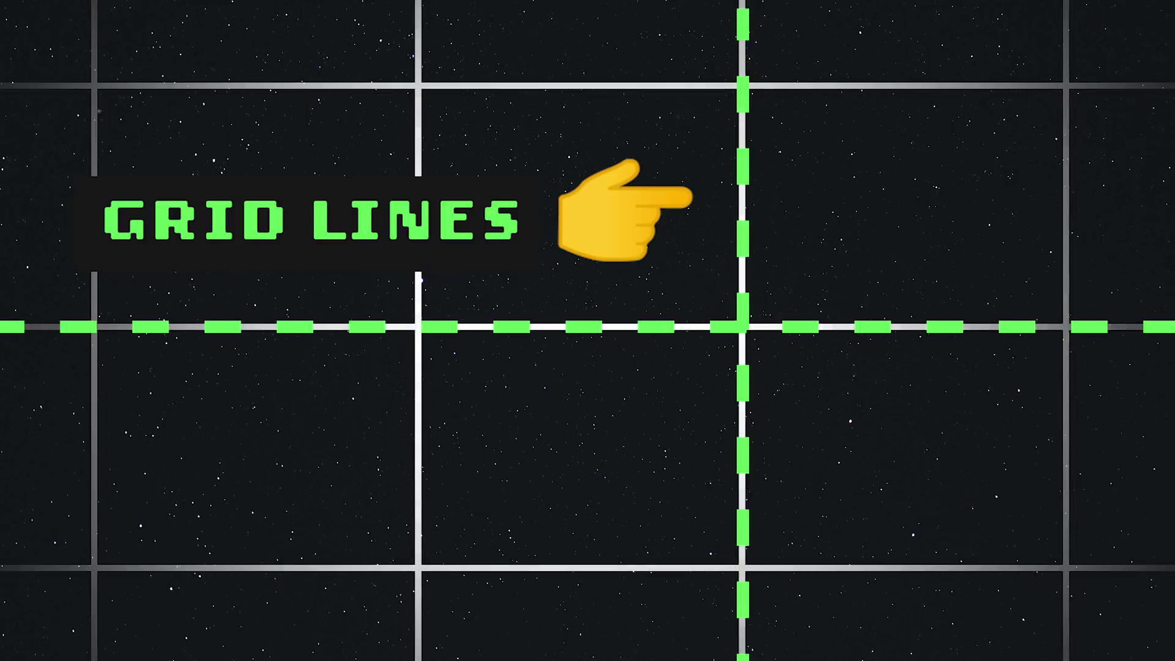

Slide 5
GRID CELL

